Slide 1
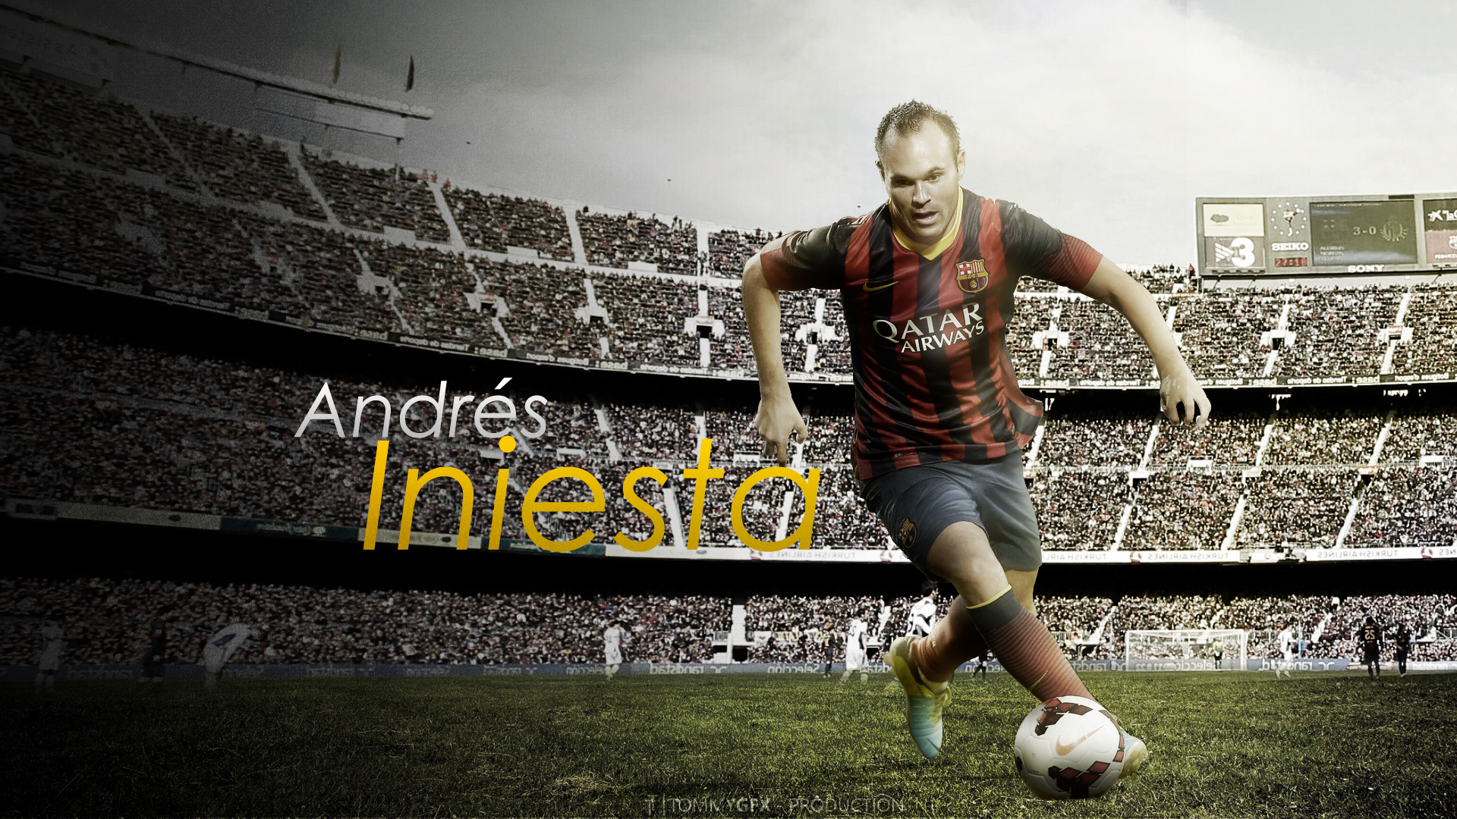

Slide 2
SELF INTRODUCTION
Name –
Roll No. –
Dept – CSE(AI & ML)
Year – 1st year
Subject Name –Language Laboratory
Subject Code – HMHU-291

Slide 3
INDEX
Title - 01
Self – Introduction - 02
Index - 03
Acknowledgement - 04
Introduction of Andres Iniesta - 05
Birth - 06
La Masia - 07
FC Barcelona – The club of his life - 08
Xavi and Iniesta the best midfield duo ever - 09
Vissel Kobe - 10
International debut - 11
World Cup winning goal - 12
Farewell - 13
Honors - 14
Conclusion - 15
Bibliography - 16
Thanking slide - 17

Slide 4
ACKNOWLEDGEMENT
I WOULD LIKE TO EXPRESS MY SPECIAL THANKS OF GRATITUDE TO MY TEACHER Mr . ARNAB CHAKRABORTY WHO GAVE ME THE GOLDEN OPPORTUNITY TO DO THIS WONDERFUL PRESENTATION .
THIS PRESENTATION ALSO HELPED ME IN DOING A LOT OF RESEARCH AND I CAME TO KNOW ABOUT SO MANY NEW THINGS.
I AM EXTREMELY GRATEFUL TO MY PARENTS AND MY FRIENDS WHO GAVE VALUABLE SUGGESTIONS AND GUIDANCE FOR COMPLETION OF MY PRESENTATION . THIS COOPERATION AND HEALTHY CRITICISM CAME HANDY AND USEFUL WITH THEM .
HENCE , I WOULD LIKE TO THANKL ALL THE ABOVE MENTIONED PEOPLE ONCE AGAIN.

Slide 5
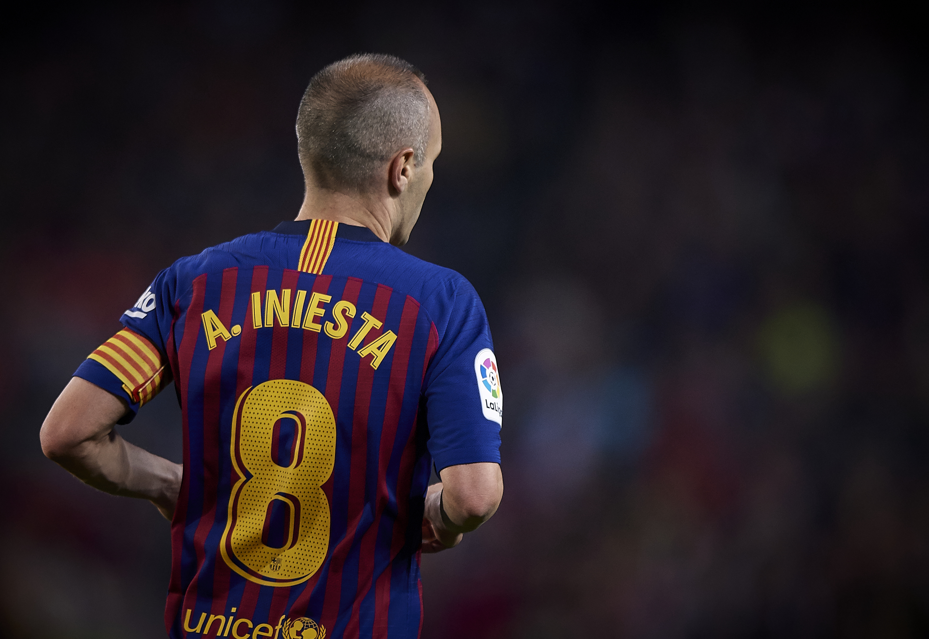
INTRODUCTION OF ANDRES INIESTA
ANDRES INIESTA LUJAN IS A SPANISH PROFESSIONAL FOOTBALLER WHO PLAYS AS A MIDFIELDER . CONSIDERED ONE OF THE GREATEST MIDFIELDER OF ALL TIME, INIESTA HAS SPENT MOST OF HIS CAREER AT BARCELONA , WHERE HE SERVED AS A CAPTAIN FOR THREE SEASONS.

Slide 6
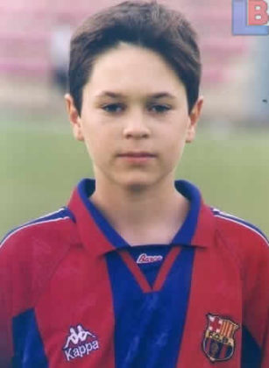
BIRTH
ANDRES INIESTA LUJAN WAS BORN ON MAY 11 , 1984(38 YEARS) , FUENTEALBILLA , SPAIN

Slide 7
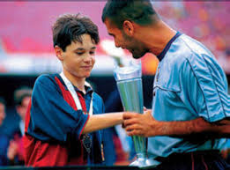
LA MASIA
Iniesta came through La Masia, the Barcelona youth academy, after an early migration from his birthplace, and impressed from an early age. He made his first-team debut aged playing regularly during the 2004–05 season and remained in the team until 2018.

Slide 8
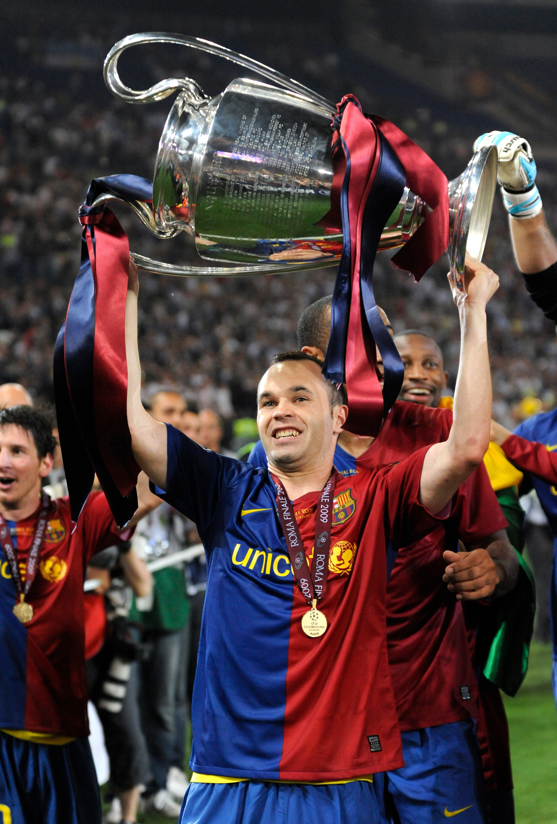
FC BARCELONA – THE CLUB OF HIS LIFE
Iniesta was an integral part of the Barcelona sides that won two historic trebles in 2009 and 2015, and his 35 trophies, which includes nine La Ligas and four UEFA Champions League titles, make him the most decorated Spanish footballer.

Slide 9
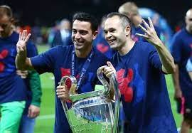
XAVI AND INIESTA -THE BEST MIDFIELD DUO EVER
Their intensity and love for the game make them the ideal teammates and leaders. Both started for Spain's World Cup Champion squad—that they both play for the same club team is just plain unfair to the other clubs around Europe. They are the best midfield duo in the world.

Slide 10
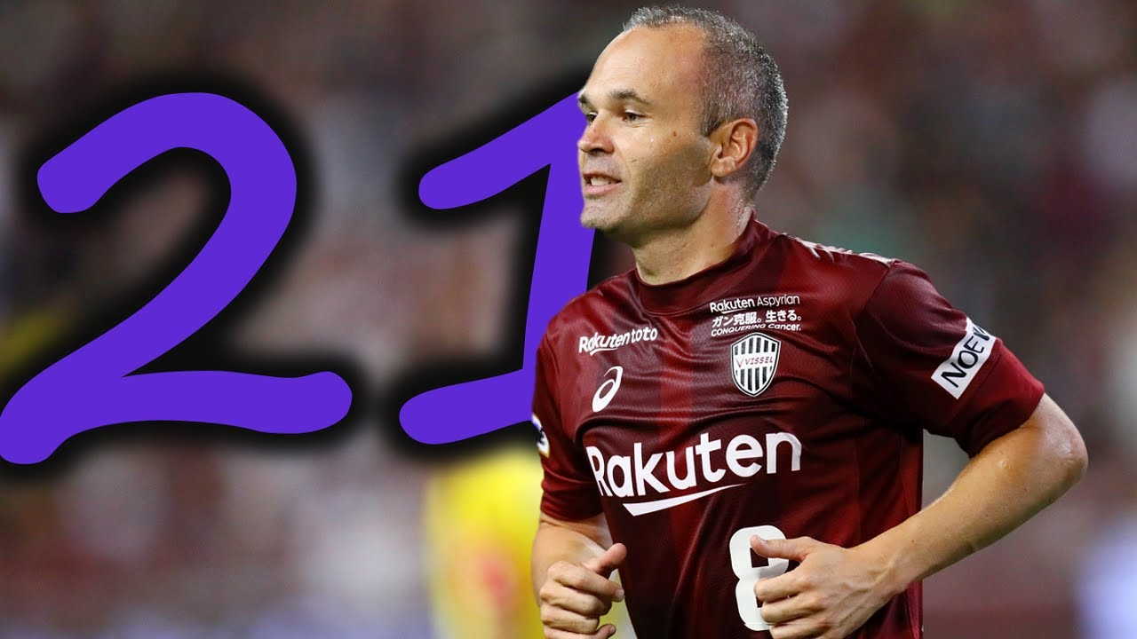
VISSEL KOBE
On 24 May 2018, Japanese club vissel Kobe announced the signing of Iniesta on a
three-year deal. He made his debut on 22 July, coming on as a second-half substitute for kazuma watanbe in a 0–3 defeat against Shoran Bellmore. On 1 January 2020, he won his first trophy in Japan, starting in Vissel Kobe's 2–0 victory over Kashima Antlers in the final of the 2019 Emperor's Cup A month later, he also won the 2020 Japanese super cup] On 7 December 2020, Iniesta suffered a tear of the rectus femoris muscle during a 2–0 win in the round of 16 of the 2020 AFC Champions League against Shanghai SIPG in which he also scored the first goal of the game. He had a successful surgery in Barcelona a few days later. On 11 May 2021, Iniesta signed a contract extension with Vissel Kobe, keeping him at the club for another two seasons. On 11 November 2021, he was named J.Lea`gue Monthly MVP after scoring three league goals in October. He was named in the 2021 J.League Best XIon 6 December 2021. On 14 May 2022, Iniesta scored a goal and guided Vissel Kobe to first league win of the 2022 season in a 4–0 win over Sagan Tosu International career.

Slide 11
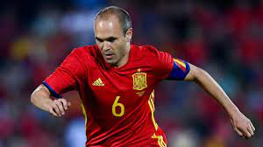
INTERNATIONAL DEBUT
NUMBER – 6 POSITION-MIDFIELDER 2003-2006 –U-21 2006-2018-SPAIN NATIONAL TEAM Iniesta was selected in Spain's squad for UEFA Euro 2006 in Austria and Switzerland . He played the duration of the final in Spain's 1–0 win over Germany. Iniesta was named in the Team of the Tournament alongside fellow Spain midfielders XavI, Marcos Sennaand six other teammates. Iniesta did not participate in the 2009 FIFA Confederations Cup in South Africa due to a thigh muscle injury; Spain was eliminated from the tournament at the semi-final stage.

Slide 12
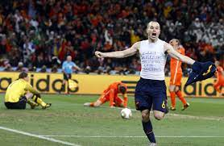
WORLD CUP WINNING GOAL
On July 11 2010, Andrés Iniesta scored the winning goal in the 116th minute as Spain beat the Netherlands 1-0 in the World Cup final. In his celebration, the Spanish player unveiled a shirt in which he had written Dani Jarque, always with us'. Jarque, who was RCD Espanyol's captain, had passed away in August 2009.

Slide 13
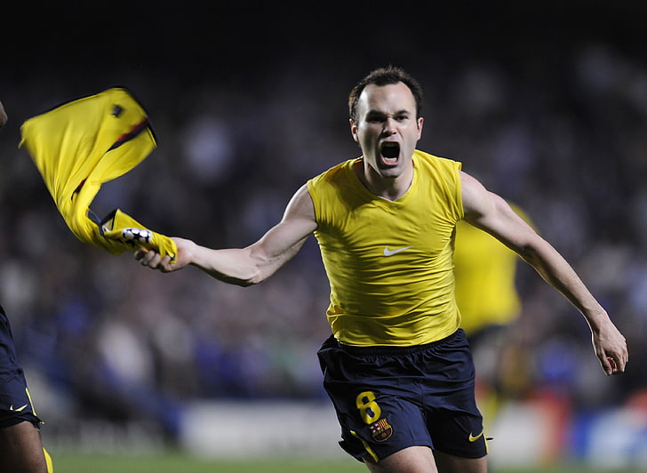
FAREWELL
FC BARCELONA - He played the 650th game of his career for Barcelona against Levante on 7 January 2018, he was replaced by André Gomes after 76 minutes as the game ended 3–0 in favour of Barcelona. Despite signing a lifetime contract, on 27 April 2018, Iniesta announced he would be leaving Barcelona by the end of the season winning 35 titles with the club
SPAIN-He came off the bench in the 67th minute in Spain's last match at the fifa world cup against Russia on 1 July 2018 for the round of 16. After the loss in the penalty shoot-outs, Iniesta announced his retirement from international duty.

Slide 14
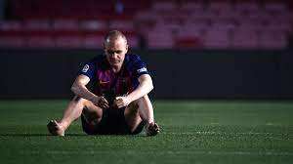
HONOURS
La Liga : 9
Copa del Rey : 6
Supercopa de Espana : 6
UEFA Champions League: 4
UEFA Super Cup : 2
FIFA Club World Cup : 3
BARCELONA
INDIVIDUAL
UEFA Euro Team of the Tournament : 2008,2012
La Liga Vest Spanish Player :2009
La Liga Best Midfielder : 2009, 2011, 2012, 2013, 2014
SPAIN
FIFA World Cup : 2010
UEFA European Championship : 2008, 2012

Slide 15
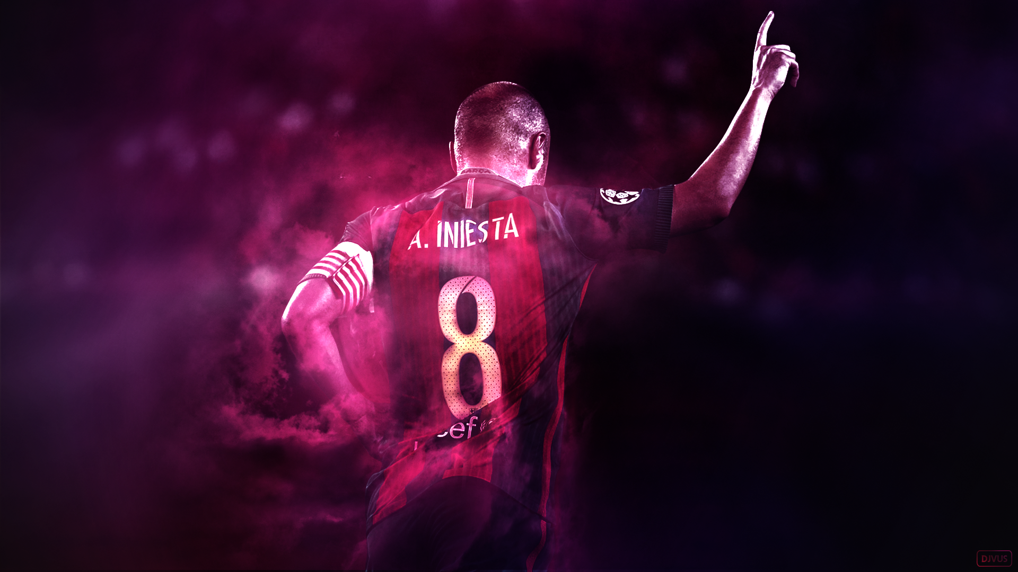
CONCLUSION
Andres Iniesta is regarded as one of the best to play the game in the history of football. And inspired millions of people around the globe .

Slide 16
BIBLIOGRAPHY
Information :
Wikipedia , Google
Images:
99 images.com
Pinterest.com
Alamy.com
Etc.

Slide 17
THANK YOU

